Slide 1
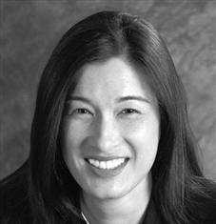
I support FPA Diversity Programs because…
FPA's vision can ultimately be realized by welcoming individuals from diverse backgrounds who support the financial planning process.
Diversity within the financial planning industry begins with the FPA Community.
Rita Cheng, CRPC®, CFP®

Slide 2
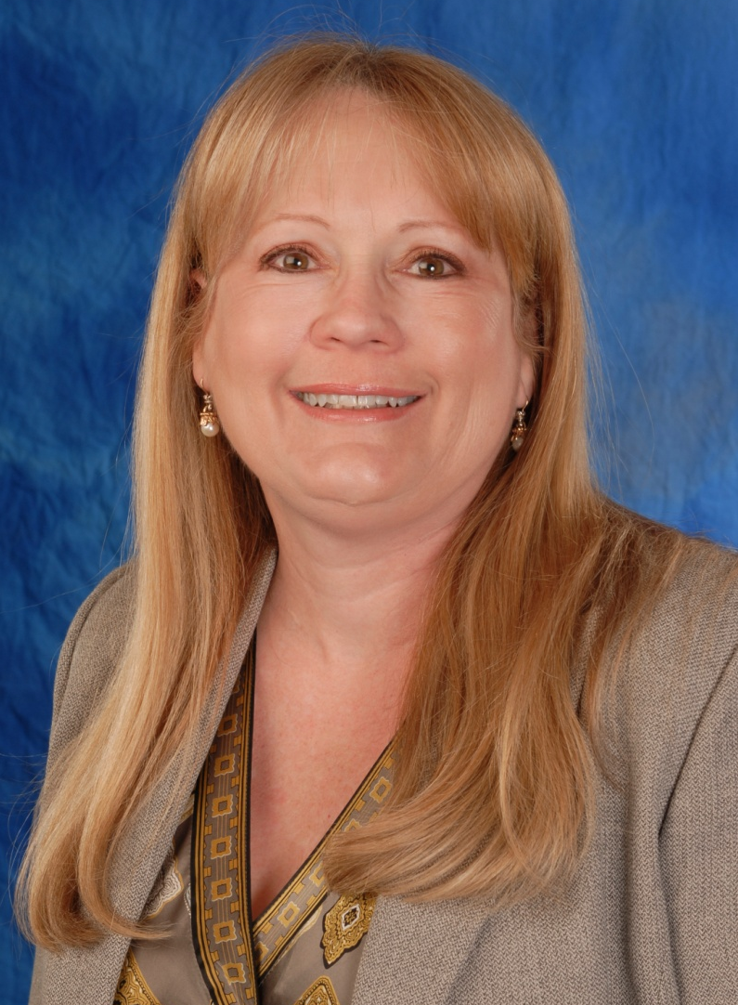
I support FPA Diversity Programs because…
Diversity is a key building block of the financial planning profession. We each bring unique experiences and approaches to planning; but are unified in our mission to help others.
Supporting the diversity in our profession ensures it will continue to grow and thrive.
Diana DeCharles, MBA CFP®

Slide 3
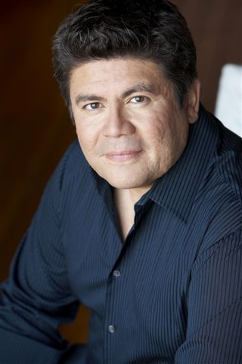
I support FPA Diversity Programs because…
The future of the FPA will be determined by the awareness that the demographics of minorities, especially the Hispanic community, is growing at unprecedented rates. Making them feel included and involved will be a turning point for our organization.
Louis Barajas

Slide 4
I support FPA Diversity Programs because…
I strongly believe in the words of one of my favorite quotes:
“Diversity is the one true thing we all have in common.
Celebrate it everyday.”
This embodies everything the FPA Diversity initiative stands for!
Ed Gjertsen, CFP®

Slide 5
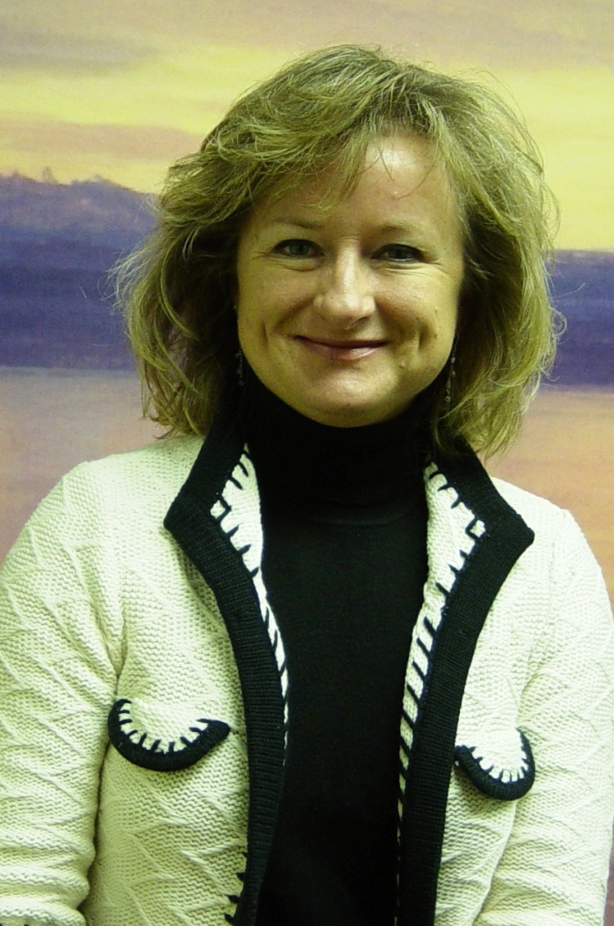
I support FPA Diversity Programs because…
Diversity expands our reach and helps us touch more people with the value of financial planning.
It makes our FPA community stronger through shared understanding of the challenges and experiences of people different from ourselves.
Janet Stanzak, MS, CFP®

Slide 6
I support FPA Diversity Programs because…
The destiny of the FPA is to create a world where everyone thrives and prospers. Ensuring that planners and consumers of all ethnicities, genders, religions, abilities and preferences are included is an inextricable part of reaching our shared destiny.
Lee Baker, CFP®

Slide 7
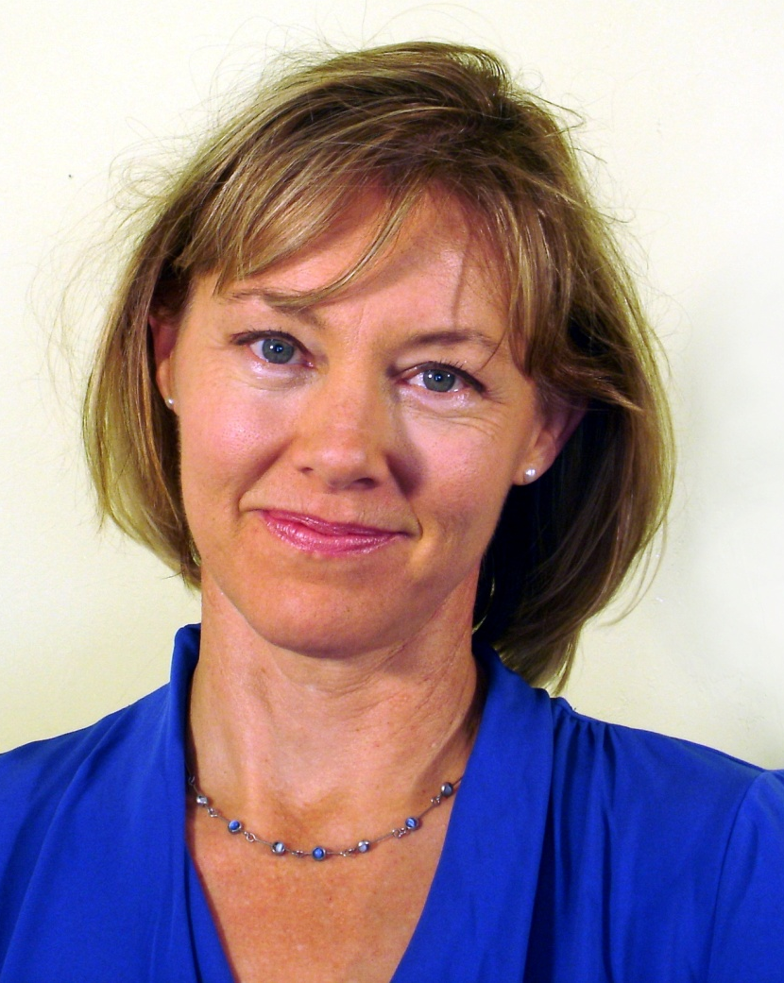
I support FPA Diversity Programs because…
The range, integrity and richness of FPA’s reach will be a direct reflection of our own community tapestry. Our strength resides not only in our ability to weave but in our choice of threads.
Gretchen Gates, CFP®

Slide 8
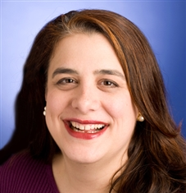
I support FPA Diversity Programs because…
By impacting the public conversation about the financial planning profession, FPA helps create a “virtuous cycle” where a more diverse population is encouraged to enter the profession by a diverse client base that is clamoring to be served.
Marie Isabel Laurion, CFP®, CRPC®
FPA Diversity Scholarship recipient

Slide 9
I support FPA Diversity Programs because…
FPA’s diversity initiative provides a great platform to merge a changing U.S. population with the next generation of financial planners, who will need the knowledge & tools to reach all communities. It is vital to create an ongoing and trusting partnership between planners and the general public.
Leighann Miko
FPA Diversity Scholarship recipient

Slide 10
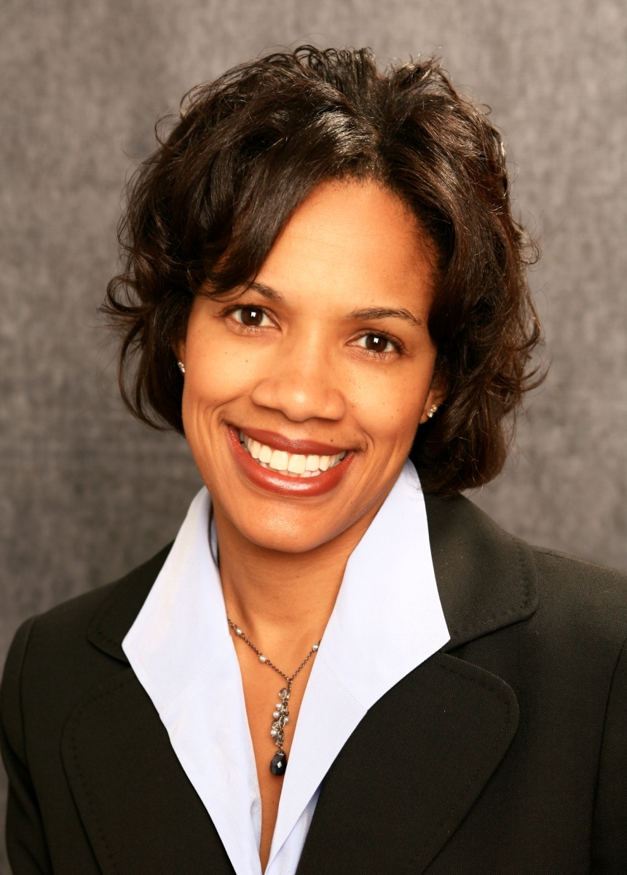
I support FPA Diversity Programs because…
They provide a seat at the table to all who should be heard and well-served by the financial planning profession. The programs expand opportunities to enrich, and be enriched by, increasingly diverse communities seeking the assistance of culturally-conscious financial planners.
Lazetta Braxton
FPA Diversity Scholarship recipient

Slide 11
I support FPA Diversity Programs because…
Despite the fact that the consumers served by financial planners are diverse in all ways, the profession is represented by a fairly homogenous group of planners.
FPA recognizes the importance of building greater diversity in the professional ranks.
Rob Hoxton, CFP®, AAMS, AIF®

Slide 12
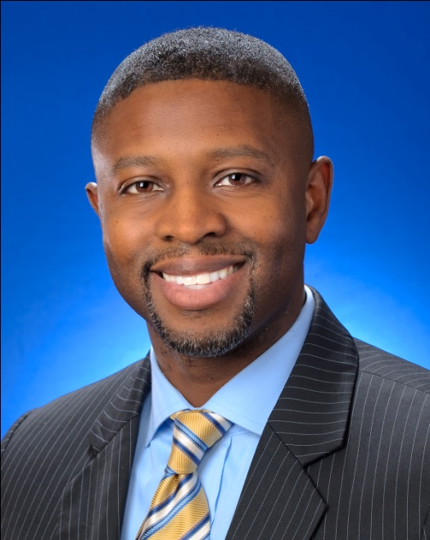
I support FPA Diversity Programs because…
FPA’s focus on diversity could not be more timely. Minorities make up 35% of the U.S. population representing more than $1.4 trillion of discretionary spending. The opportunity has never been greater to serve such a well connected community and provide them with the counsel of accredited and competent professional planners.
Michael Schiele
FPA Diversity Scholarship recipient

Slide 13
I support FPA Diversity Programs because…
To be relevant, our profession must reflect the demographics of society.
It is incumbent upon FPA to open doors for those who may be a part of – or be helped by – our profession.
Mark Prendergast, CFP®

Slide 14
I support FPA Diversity Programs because…
Diversity includes a variety of aspects including diversity in financial planning careers and occupations. Financial planners are greatly needed in various types of organizations and in various roles to serve diverse communities.
Mary Bell
FPA Diversity Scholarship recipient

Slide 15
I support FPA Diversity Programs because…
Our profession should better resemble the diverse backgrounds of our clients.
FPA's Diversity programs provide access to information, opportunities for personal growth, and tools for success to financial planners from all walks of life.
Michael Branham, CFP®

Slide 16
FPA Diversity Scholarship Winners
Jennifer Arroyo (2009)
Mary Bell (2010)
Lazetta Rainey Braxton (2011)
Gretchen Gates (2011)
Julian Johnson (2010)
Marie Isabel Laurion (2011)
Rebecca Ligtenberg (2009)
Leighann Miko (2010)
Lanta Evans Motte (2010)
Sheena Parker (2009)
Michael Schiele (2011)
Janine Scott (2009)
Danielle Winchester (2009)

Slide 17
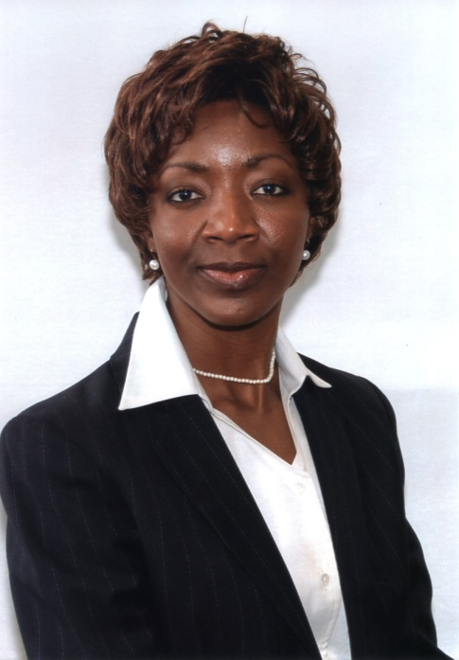
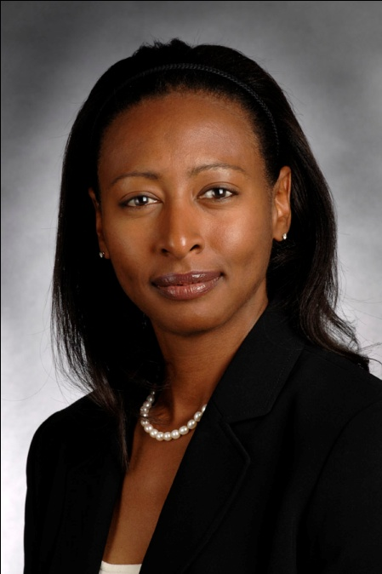
FPA Diversity Scholarship Recipients

Slide 18
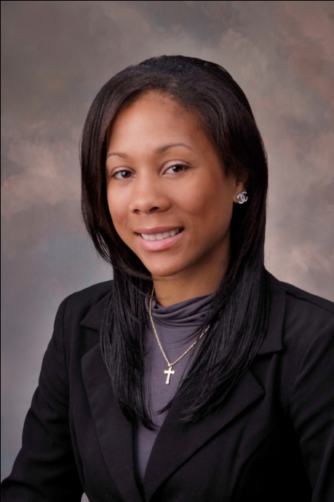
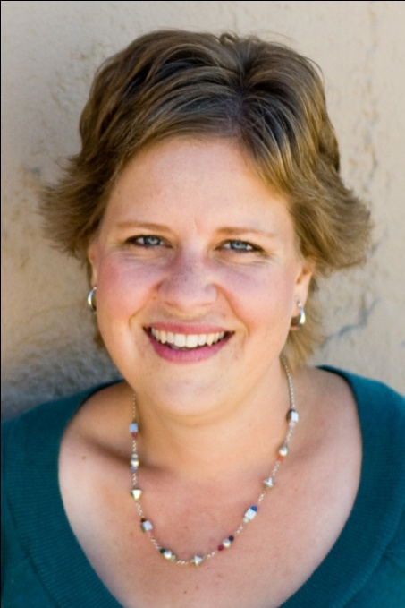
FPA Diversity Scholarship Recipients

